Slide 1


Hannover University
Contact Us
About Us
Contact Us
About Us
Search Here...
UNIVERSITY OF BARISHAL
UNIVERSITY OF BARISHAL .
Course Title : Financial Management
Course Code : F-206
Course Title : Computer Fundamentals and Office Applications
Topics : CML + Capital structure
Presentation by :
Team No : 06
Presented by

Slide 2




COURSE TITLE
“ Effects of
performance of Bashundhara Paper Mills Ltd. and Sonali Paper & Board Mills Ltd. “

Slide 3

BASHUNDHARA PAPER MILLS LTD
COMPANY OVERVIEW
The company was founded by Ahmed Akber Sobhan. The company was incorporated in Bangladesh on September 28,1993 as a private limited company having its registered office in Dhaka.
The Bashundhara Paper Mills Ltd. is a subsidiary of the Bashundhara Group, one of Bangladesh’s largest industrial conglomerates. The company specializes in the production of various paper and paper products, including writing and printing paper, packaging paper and tissue paper.

Slide 4

BASHUNDHARA PAPER MILLS LTD

Slide 5
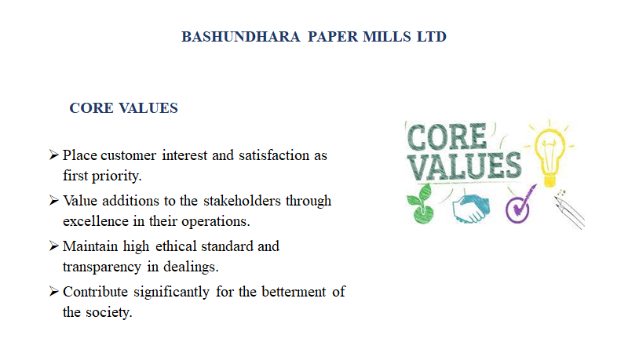
BASHUNDHARA PAPER MILLS LTD

Slide 6
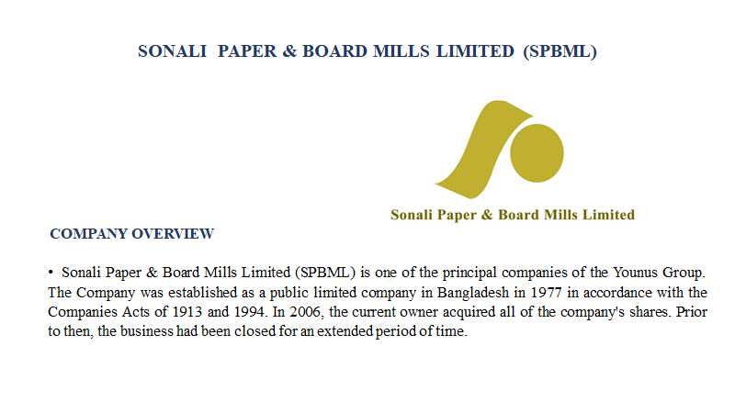
Presented by
ID :
SONALI PAPER & BOARD MILLS LIMITED (SPBML)

Slide 7
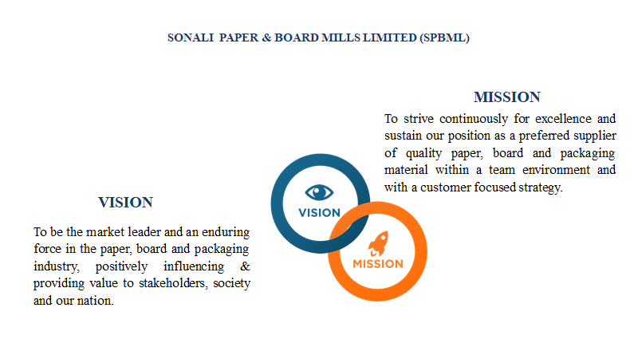
Presented by :
ID :
SONALI PAPER & BOARD MILLS LIMITED (SPBML)

Slide 8
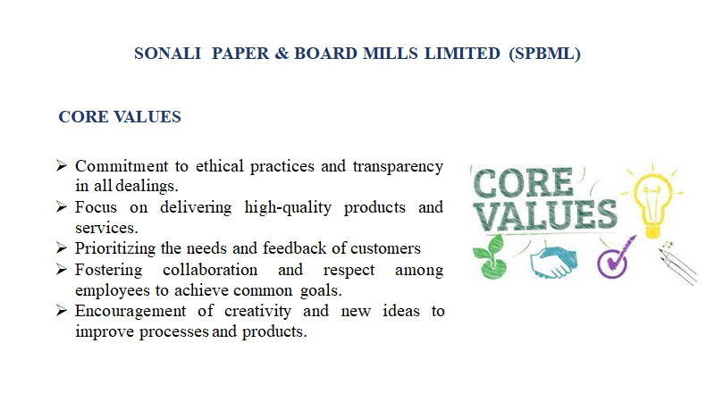
Presented by :
ID :
SONALI PAPER & BOARD MILLS LIMITED (SPBML)

Slide 9
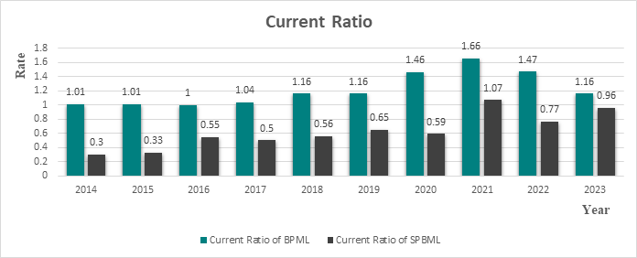
Presented by :
ID

Slide 10
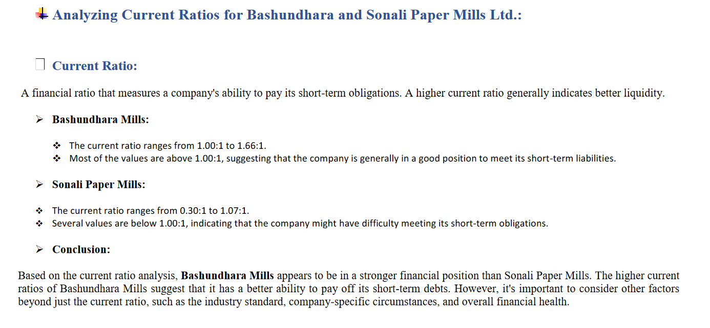
Presented by :
ID :

Slide 11
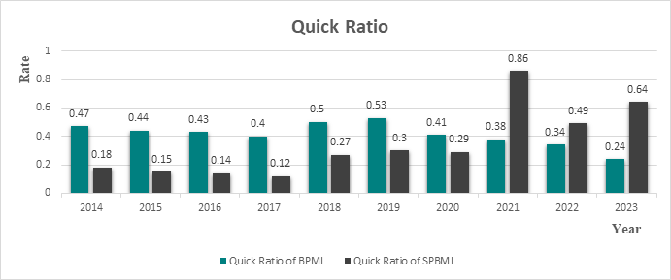
Presented by
ID

Slide 12
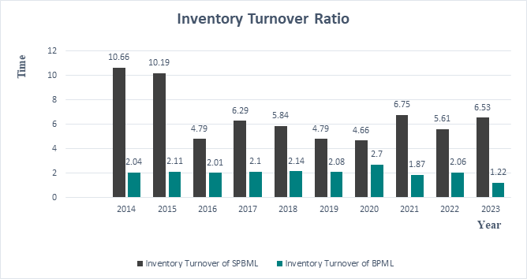
Presented by :
ID :

Slide 13
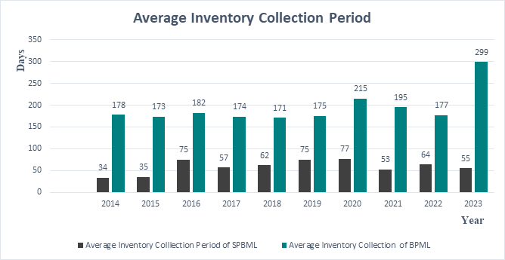

Slide 14
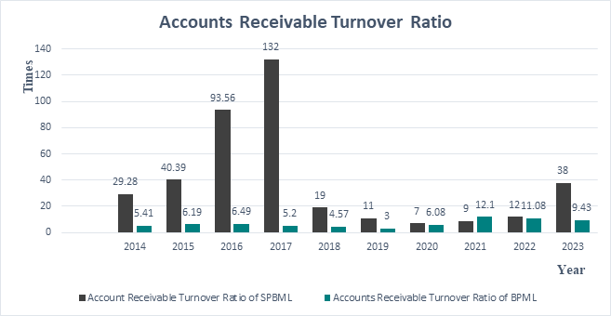

Slide 15
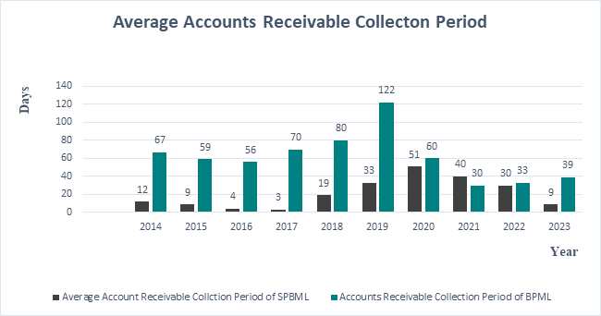

Slide 16
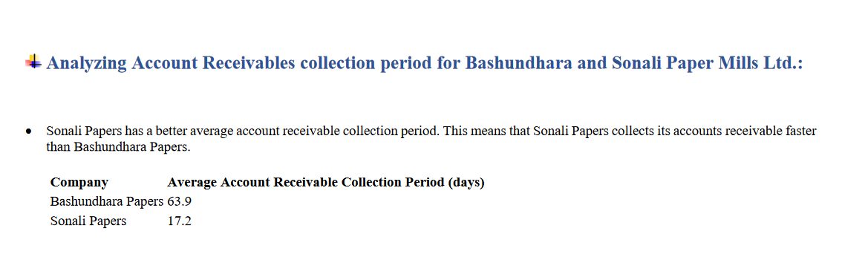
Presented by :
ID :

Slide 17
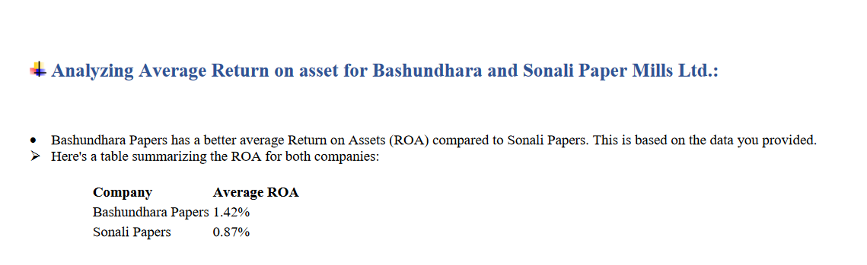
Presented by :
ID

Slide 18
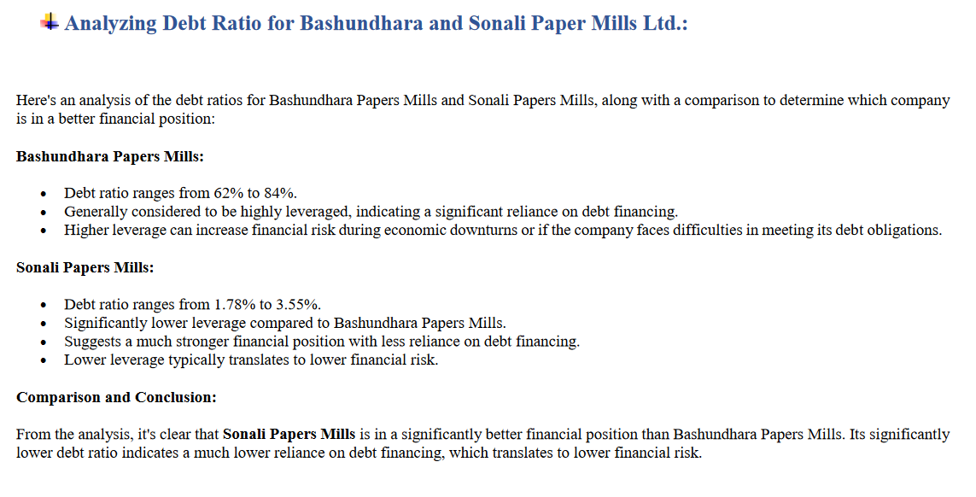
Presented by :
ID :

Slide 19
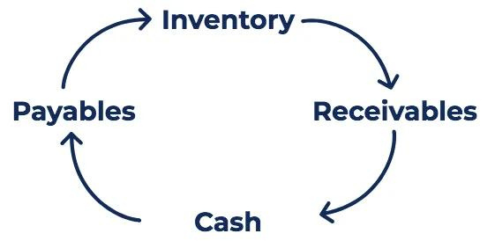
Presented b
ID :
Cash Conversion Cycle
The Cash Conversion Cycle (CCC) is a metric that shows the amount of time it takes a company to convert its investments in inventory to cash. The conversion cycle formula measures the amount of time, in days, it takes for a company to turn its resource inputs into cash.

Slide 20
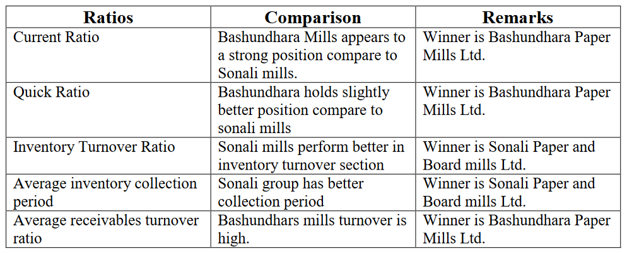
Comparison and Conclusion

Slide 21

Presented by
Hannover University
About Us
Contact Us
Search Here...
THANK YOU !

